Slide 1



Merevolusi Operasi Menara Telco Indonesia dengan IBM watsonx.AI
Memberdayakan Efisiensi, Kinerja, dan Pertumbuhan

Slide 2
Pasar Menara Telco Indonesia: Dinamis & Penuh Potensi
Lingkungan Dinamis Infrastruktur Telco Indonesia
Pertumbuhan Kuat: Didorong penetrasi internet, adopsi seluler, dan komitmen pemerintah terhadap digitalisasi (Indonesia Emas 2045).
Investasi Infrastruktur: Peningkatan signifikan dalam pengembangan 4G/5G dan serat optik, dengan 5G diproyeksikan jadi pendorong pendapatan utama.
Ekspansi Jaringan: Fokus pada perluasan jangkauan ke wilayah yang belum terlayani (misalnya, Indonesia Timur, 3T).

Slide 3
Visi IBM: Membangun Telco yang Lebih Cerdas dengan AI
IBM melihat AI sebagai fondasi utama untuk jaringan telco yang otonom, efisien, dan berpusat pada pelanggan.
Jaringan Otonom: AI mengoptimalkan operasi, mengurangi intervensi manual, dan meningkatkan kinerja jaringan secara real-time.
Pengalaman Pelanggan Unggul: AI mempersonalisasi layanan, mempercepat resolusi masalah, dan membangun loyalitas.
Efisiensi Biaya & Inovasi: AI mendorong pengurangan biaya operasional dan membuka peluang pendapatan baru melalui wawasan data.

Slide 4
Tantangan Kritis dalam Operasi Menara Telco
Poin-Poin Masalah Utama Operator Menara Telco
Biaya Operasional Tinggi: Pemeliharaan reaktif, konsumsi energi, dan proses manual yang tidak efisien.
Kinerja Jaringan & Waktu Henti: Kemacetan, kualitas sinyal yang tidak konsisten, dan pemadaman yang tidak terencana.
Manajemen Aset yang Kompleks: Kurangnya visibilitas aset, perbedaan "As-Built", dan peluang monetisasi yang terlewatkan (co-location).
Data Terfragmentasi: Kesulitan integrasi & analisis data dari berbagai sistem untuk wawasan berarti.

Slide 5
Solusi AI Tingkat Perusahaan IBM untuk Telekomunikasi
IBM watsonx:
watsonx.ai: Studio AI untuk membangun, melatih, dan menerapkan model AI (termasuk Generative AI).
watsonx.data: Data lakehouse yang aman dan diatur untuk beban kerja AI Anda.
watsonx.governance: Alat untuk memastikan AI yang bertanggung jawab, transparan, dan patuh.
IBM Maximo Application Suite:
Memanfaatkan AI & IoT untuk pemeliharaan prediktif dan manajemen kinerja aset menara.
IBM Cloud for Telecommunications:
Arsitektur hybrid cloud yang terbuka, dioptimalkan untuk beban kerja telco dan AI.

Slide 6
Put AI to work with watsonx.AI.
IBM watsonx is a portfolio of AI products that accelerates the impact of generative AI in core workflows to drive productivity.
Notes:
That is why IBM brought to market watsonx, a portfolio of AI products that accelerate the impact of AI in core workflows to drive productivity within an organization.

Slide 7























watsonx.ai delivers core capabilities in the AI stack
AI assistants and agents ​
Developer toolkit: ​ Tools, frameworks, templates, deployments​
Integrated governance​
Models
Enterprise-scale collaboration and workload management
Hybrid cloud platform​
Notes:
Watsonx.ai meets developers where they are to provide tooling that innovates across the entire AI technology stack.
The platform offers a unified AI development experience with access to foundation models, a curated set of tooling including third-party frameworks such as crewAI, SDKs and APIs and templates to be successful when developing generative AI or traditional ML solutions.
The product also offers extensions to your IDE of choice as well as our front-end UI for a low-code experience, surrounded by the various guardrails available within our watsonx portfolio to ensure security, privacy and governance.
Watsonx.ai runs on a hybrid cloud platform, integrating seamlessly into existing infrastructures, systems and processes.

Slide 8
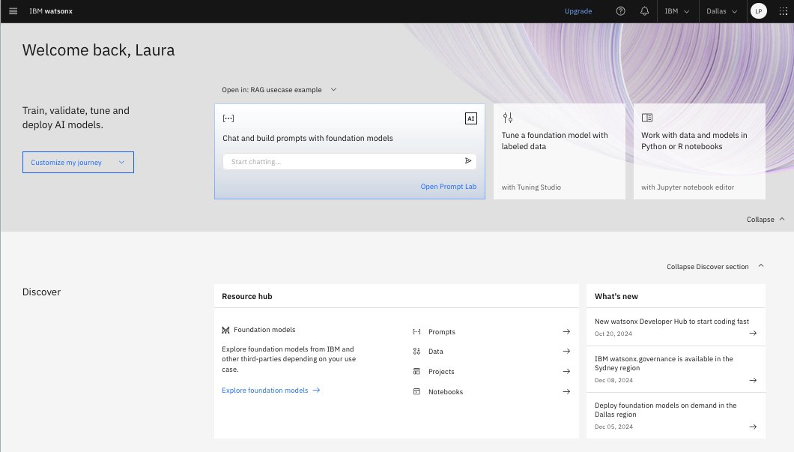
Streamline the development of AI applications with watsonx.ai
Model selection
Model customization
AI development and deployment
AI governance
Notes:
Now, let’s learn about the product features at each tier of the AI stack within watsonx.ai starting with…
Selecting the right model for your use case
Customizing your model with business specific data
AI development and deployment
And finally ensuring your AI is governed across the entire AI lifecycle

Slide 9

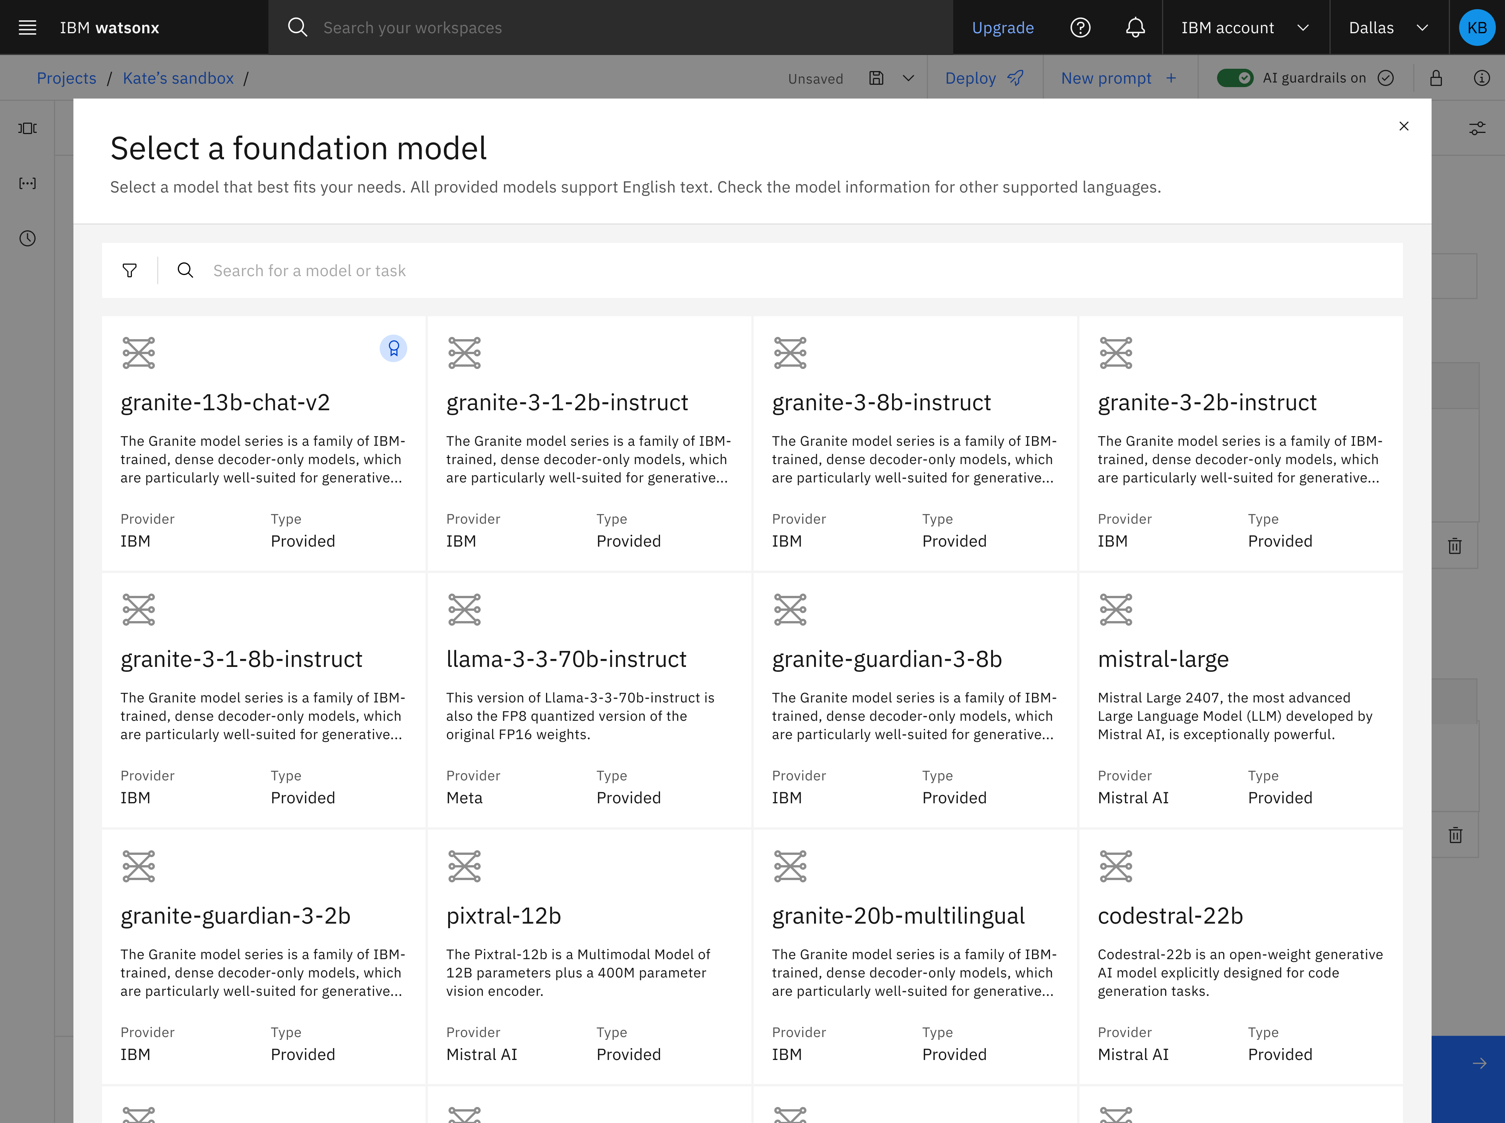
Model selection IBM offers a highly curated library—with IBM-built, open-source and third-party options—for a wide range of business requirements and budgetary considerations
Built for your business
Optimal performance and price
Multicloud
Notes:
Within the product, Developers can choose from a highly curated library of foundation models available for inference in watsonx.ai making it easy to find the models that best suit the needs of their generative AI application and budget.
In addition to working with foundation models that are curated by IBM, you can import and deploy your own custom foundation models. After the custom models are deployed and registered with watsonx.ai, you can create prompts that inference the models from the Prompt Lab and from the watsonx.ai API which we will discuss later in the presentation.

Slide 10



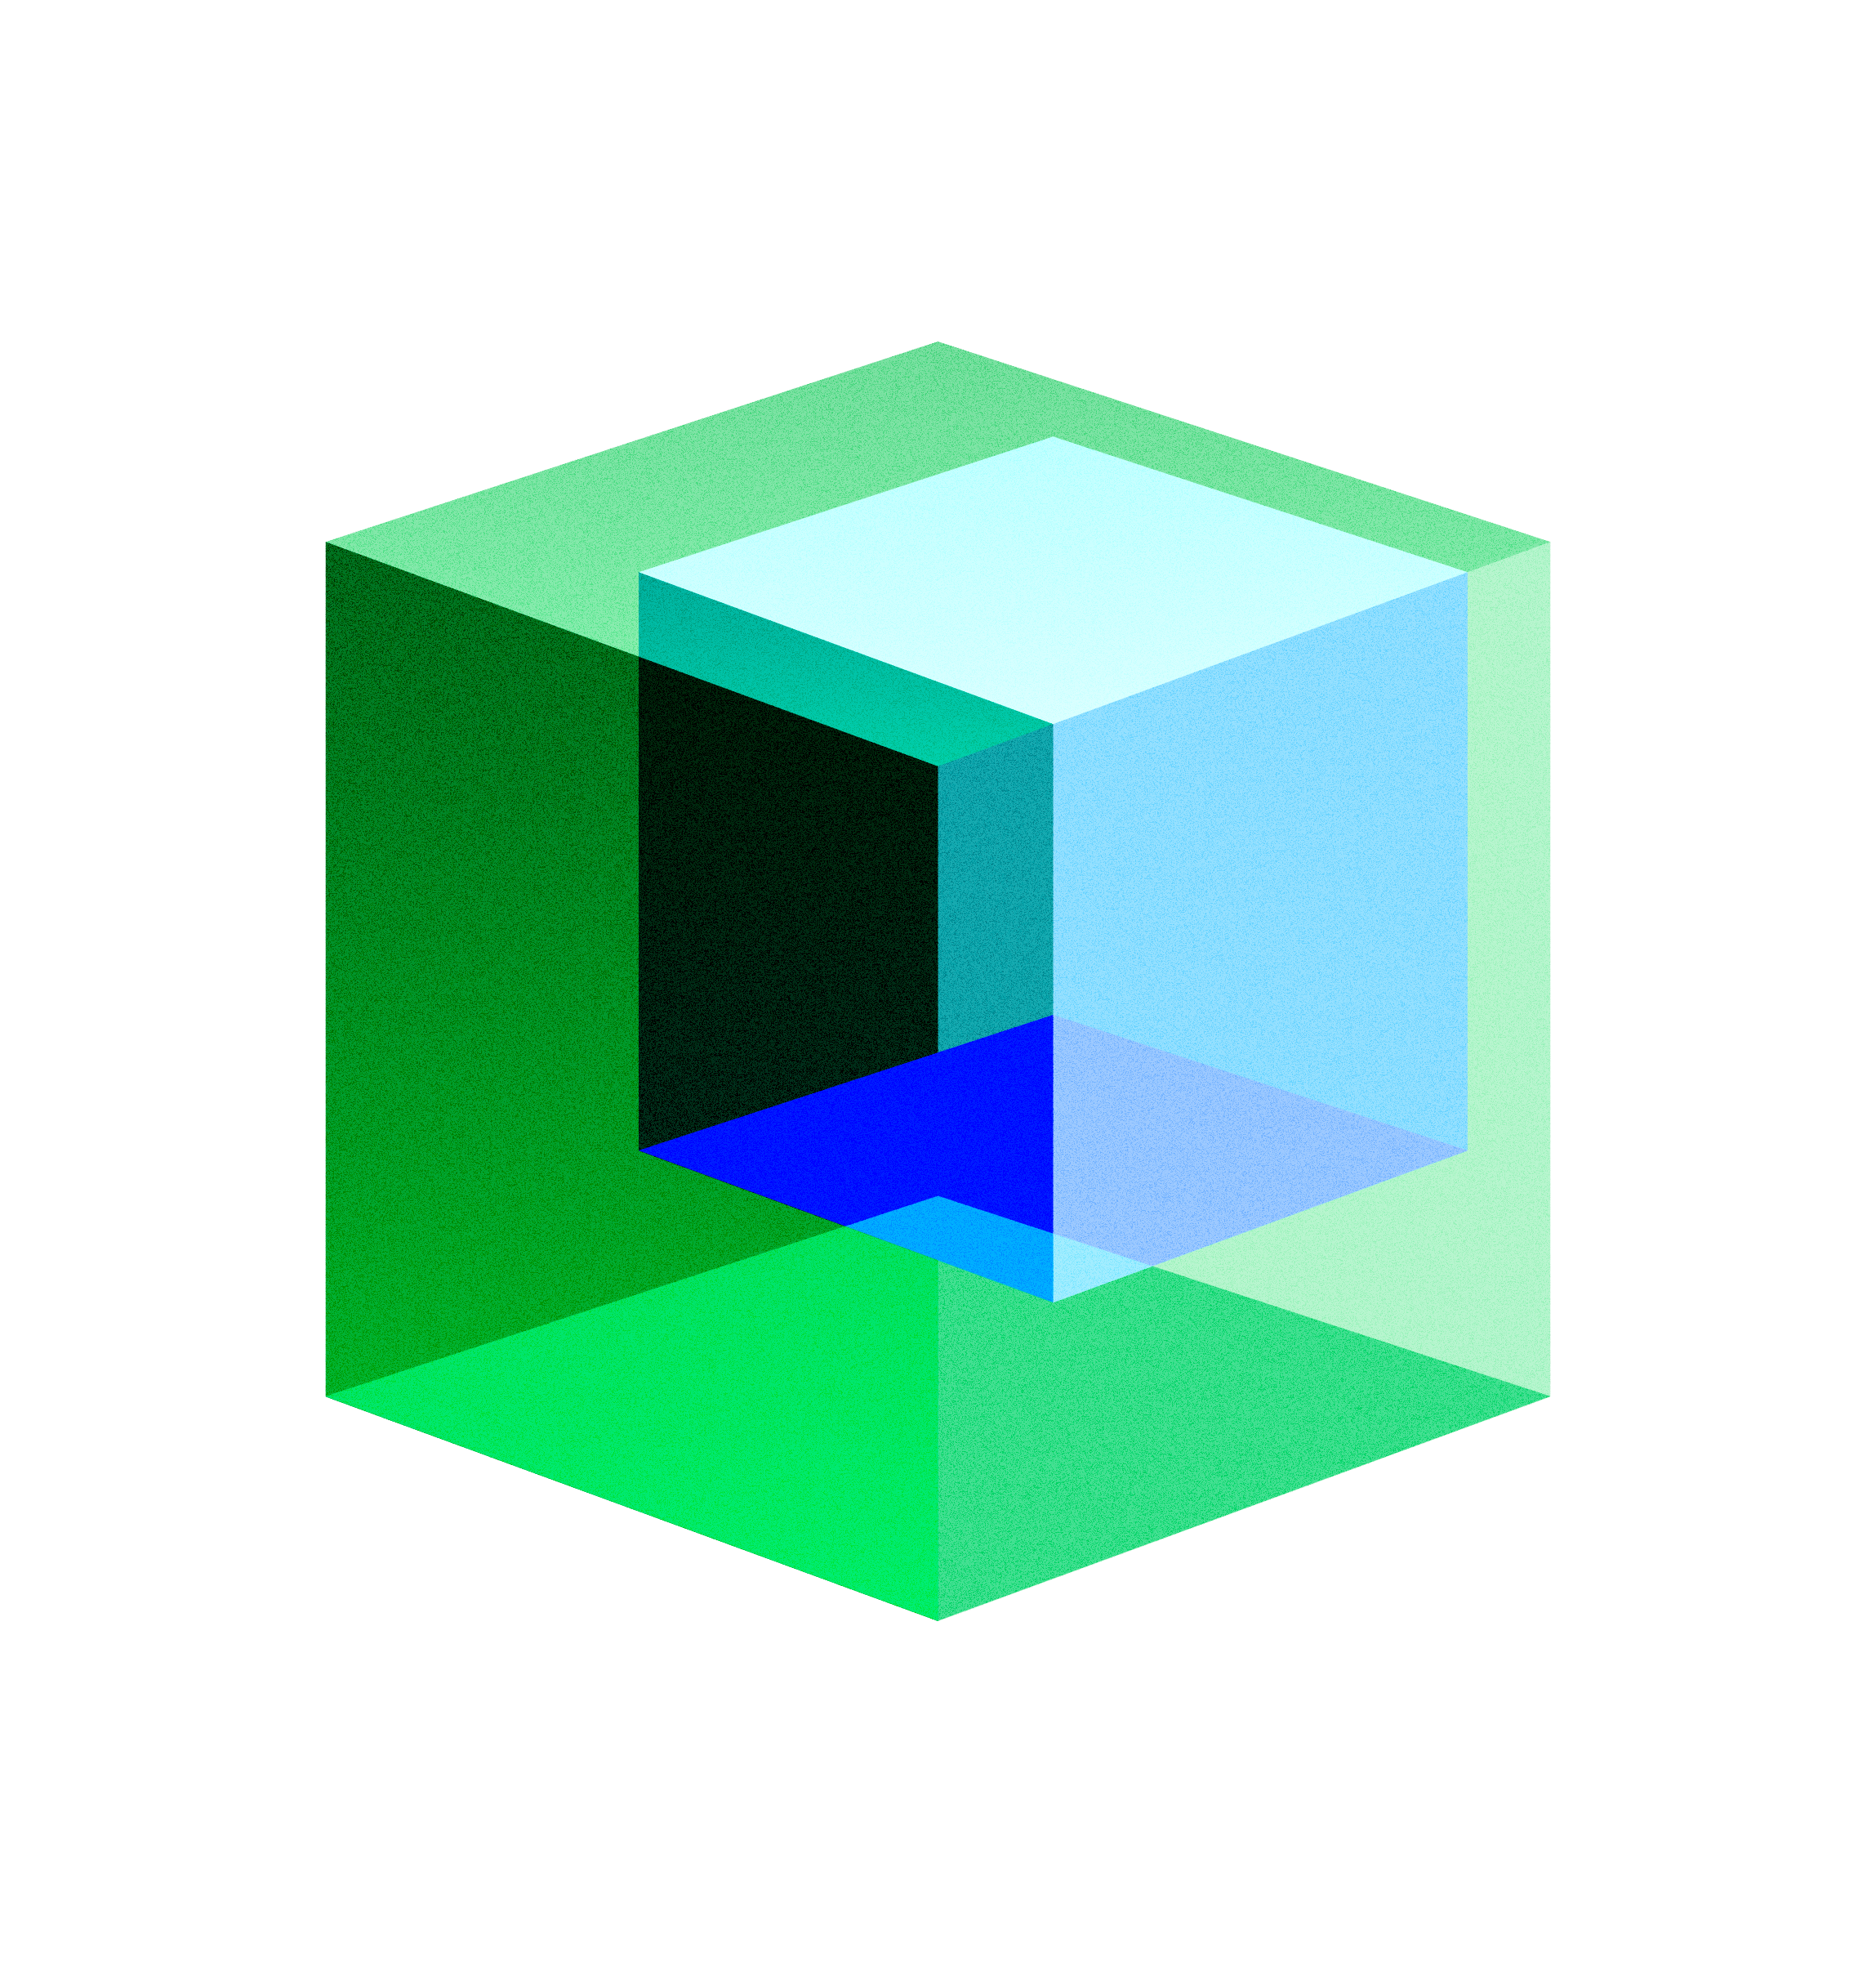









IBM Granite A family of open, performant and trusted AI models to accelerate enterprise AI adoption
Model selection
Open
Open sourced under Apache 2.0
Transparency of data, training methods
Customize with your data
Performant
Diverse range of fit-for-purpose models
Designed for scalability
Trusted
IP indemnification
Responsible and safe AI
Guardrails to secure data and mitigate risks
Granite family of models
Large Language Models (LLMs) for enterprise
Inference-efficient Mixture of Experts (MoE)
Guardrail models
Speculative decoding models
Time-series models
Geospatial models
Granite-3.0-8B-Instruct Granite-3.0-2B-Instruct
Granite-3.0-3B-A800M​ Granite-3.0-1B-A400M
Granite-Guardian-3.0-8B
Granite-Guardian-3.0-2B
Granite-3.0-8B-Instruct-Accelerator
Streamline AI development with watsonx.ai
Notes:
I’d like to introduce you to Granite.
Granite is IBM’s family of open, performant, and trusted AI models to accelerate enterprise AI adoption. ​
​
Open-sourced under Apache 2.0, all Granite models, ranging from sub-billion to 34 billion parameters deliver industry-leading accuracy and cater to diverse developer and business needs.​
​
Granite includes foundation models for code, language, time series, agents, and safety via the Granite Guardian companion model.
The biggest differentiator for Granite models is the quality of the data that trains them and the transparency IBM offers to our clients to show how our models are built and trained.​
IBM has carefully curated enterprise-grade data for training and we make those data sets transparent so you can see what went into the model. ​
Clients can adopt AI using their own data while benefiting from our IP indemnification for client protection, accuracy, and trust. ​
​With Granite, you can match the right model to the right use case for your business.

Slide 11
Model selection
Agentic workflows
Automate tasks, streamline processes and enhance operational efficiency with AI agents for business.
Example: Autonomous HR agents to support employees, talent acquisition and onboarding
Language-based tasks
Retrieval-augmented generation (RAG), summarization, content generation, insight extraction and classification based on documents or dynamic content.
Example: Building a Q&A resource from a broad knowledge base, providing customer service assistance
Code
Optimize the software development lifecycle with code-generative tasks, including code generation, code explanation and code editing.
Example: AI-generated code recommendations; IT application modernization from COBOL to Java
Granite is optimized for enterprise use cases
Power key generative AI tasks to drive your enterprise use cases.
Time series
Time-series forecasting to easily analyze current data to make predictions and help make informed decisions.
Example: Predicting future customer demand for a given product and period using historical sales and other data sources
Geospatial
Uncover patterns and trends in geographic data.
Example: NASA and IBM teamed up to create an AI foundation model for Earth observations using large-scale satellite and remote sensing data
Safety
Safeguard AI with models ensuring enterprise data security and mitigate risks across a variety of user prompts and LLM responses.
Example: AI compliance with regulatory requirements in financial services, healthcare and government
Streamline AI development with watsonx.ai
Notes:
Earlier in the presentation we talked about the enterprise use cases of Granite such as customer care, digital labor, and IT modernization, but what can developers build with Granite? Let's look at a few examples. ​
First, consider agentic workflows - We are living through a technology shift where assistants, agents, and intelligent automation are coming together to drive enterprise productivity. Granite models combined with watsonx.ai agentic tooling supports the development, deployment, and monitoring of agents for tasks such as HR, customer service, sales, procurement, and more. ​
You can build language-based tasks such as retrieval-augmented generation or RAG – RAG retrieves data from outside a foundation model and augments prompts by adding the relevant data such as a document repositories, databases, or application programming interfaces (APIs). For example, RAG with Granite can help build a broader knowledge base for customer service assistance and ultimately improve your customer experience.​
You can also use Granite for code which will speed up application modernization efforts and generate automation to rapidly scale IT environments. With Granite powering assistants such as watsonx Code Assistant developers can create high-quality code using AI-generated recommendations based on natural language requests or existing source code. ​
Easily build time series forecasts - Granite can not only incorporate historical sales data but also near-real-time data from advertising campaigns, prices, local weather forecasts, and other sources to make informed decisions. Example: Enable better inventory allocation, assortment, and replenishment planning for retailers.​
You can uncover patterns and trends in geographic data - IBM and NASA partnered to create targeted forecasts based on local observations, detecting and predicting severe weather patterns, improving the spatial resolution of global climate simulations, and improving how physical processes are represented in numerical weather and climate models.​
Finally, use Granite to safeguard AI - How do you ensure the models being used can be trusted, can scale easily and keep operating costs low? For highly regulated industries such as financial services, healthcare, and government, Granite ensures transparency of training data, within built guardrails with Granite Guardian to drive responsible AI and meet stringent compliance and regulatory requirements.​

Slide 12
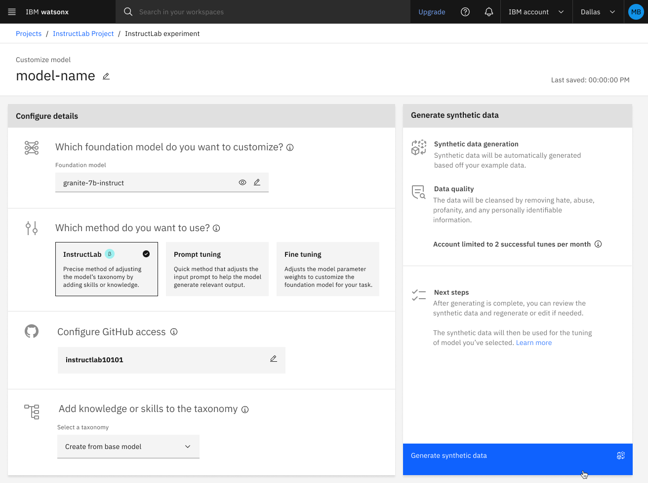
Model customization Customize models with your enterprise data without sacrificing performance
Notes:
NOTE: Instruct Lab feature is in beta.
So, how do you ensure premium model performance for your business? Commonly, through customizing the model to your industry, business or domain.
Watsonx.ai provides methods for customization in an easy-to-use format that simplifies and streamlines the process. For instance, after selecting the model you want to work with you have the option to select one of the following model customization methods:
Parameter efficient fine tuning (PEFT), such as “Prompt tuning” which doesn’t require a high volume of training data but may produce the performance gains you are looking for
Fine tuning which does require a large amount of training data but comes with the risk of high costs and catastrophic forgetting (feature available in software only)
And most recently, IBM invented the InstructLab methodology (in beta), a multi-phase alignment full fine-tuning method. InstructLab allows businesses to leverage their unique data to customize their LLMs.
All of these methods are accessible in the watsonx.ai Tuning Studio.

Slide 13
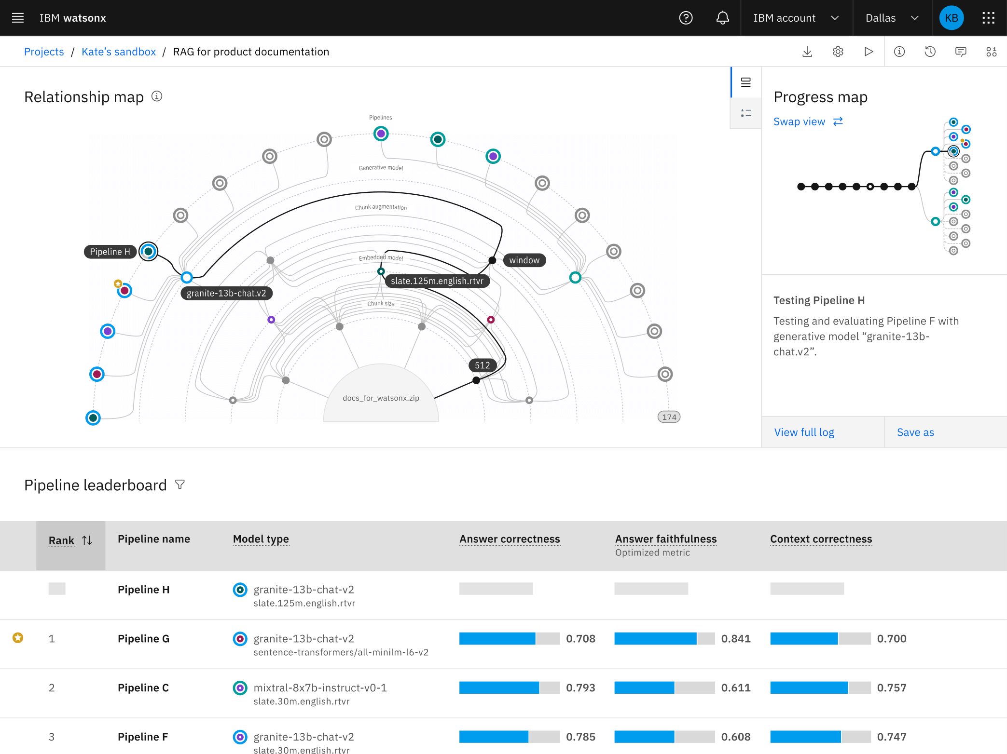
AI development and deployment Build and deploy AI/ML with pro- and low-code tools, APIs, SDKs and third-party frameworks
Notes:
NOTE: AutoAI RAG will be generally available in 1Q25.
Now that you have primed your foundation model for your business use case, watsonx.ai provides a comprehensive toolkit of pro-code and low-code tools, APIs, SDKs, and third-party frameworks such as crewAI, LangChain, and LlamaIndex, to build any AI use case imaginable.
For instance, with watsonx.ai, application developers can accelerate the AI development lifecycle by working with the low-code AutoAI RAG feature. RAG prototypes are easy to build but hard to put into production, which can require a team of experts and months of effort. AutoAI RAG will automatically produce a set of optimized RAG pipelines based on client data – while you get a cup of coffee.

Slide 14
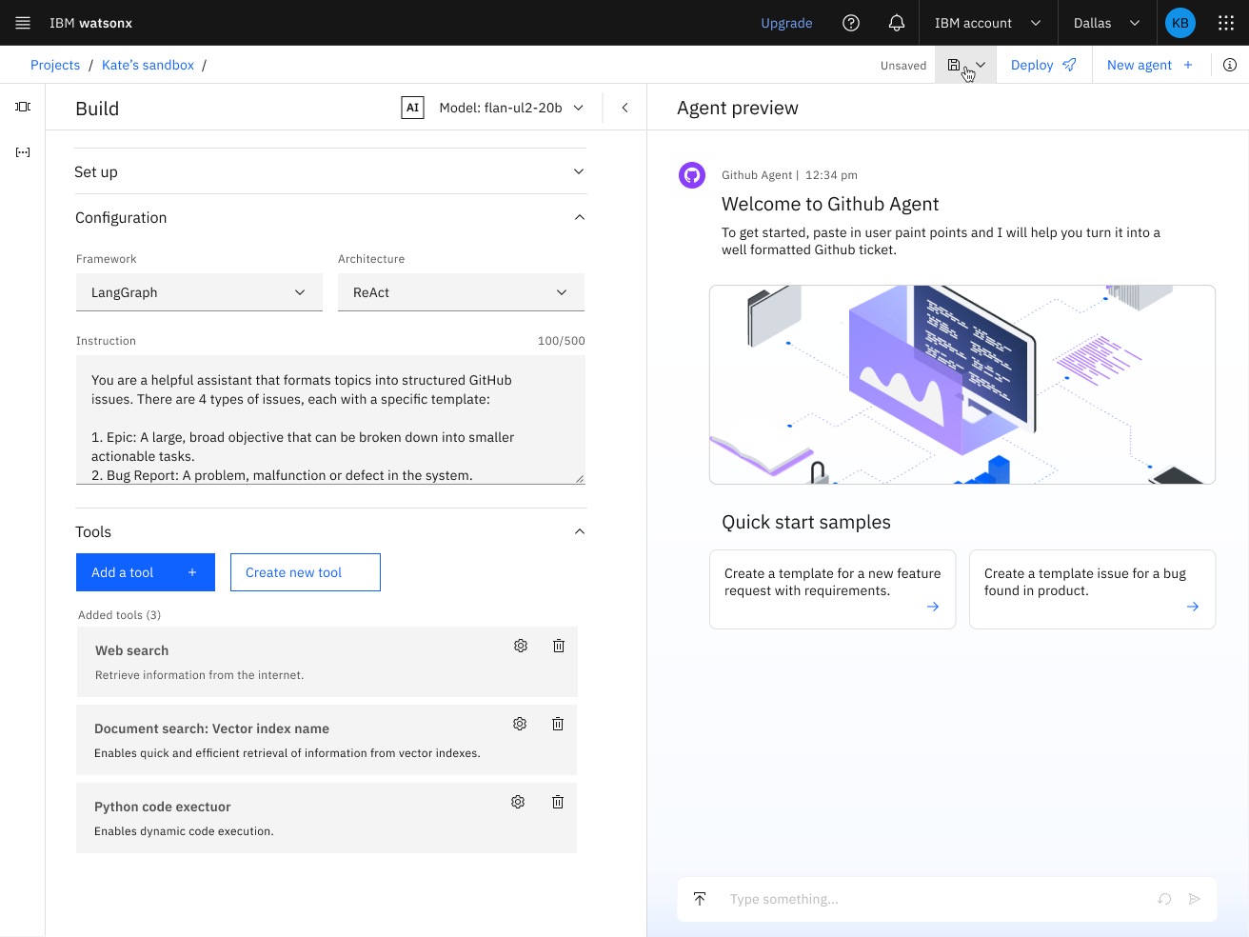
AI development and deployment Accelerate your development lifecycle by building and deploying custom agentic services using pro-code and low-code tools
Feature available in tech preview
Notes:
NOTE: Agent Lab feature is in beta.
Within watsonx.ai, developers can accelerate the development lifecycle by building and deploying custom agentic services using our intuitive visual interface, Agent Lab (in beta), or full stack pro-code tooling.
Starting with models, we offer a collection of LLMs that have large context windows and strong performance on tool calling, two key model capabilities required to enable agentic workflows.
We then move into the middleware layer which contains a set of industry standard APIs that allow clients to integrate watsonx.ai with popular, open-source frameworks, including Langraph and CrewAI, and IBM developed frameworks such as Flows Engine and Bee from IBM Research.
Finally, Agent Lab (in beta), shown here, empowers developers to deploy agents as production-ready APIs. Developers simply select the cognitive architecture they want to power their agentic system, integrate pre-built or custom tools, and deploy with “one-click” - no coding required.

Slide 15
AI development and deployment Three areas of agentic innovation
Custom-built agents
watsonx.ai Build custom-designed agents.
Design, deploy and manage AI agents with ease using pro- and low-code options.
Pre-built agents
watsonx Orchestrate Accelerate AI agent deployment.
Get started quickly with pre-built AI agents powered with business logic and seamless integration to the tools that power your business.
Multi-agent orchestration
watsonx Orchestrate
Manage all agents in one place.
Easily deploy and manage any agent for any task within a simple and unified user experience optimized to scale.
Notes:
At the beginning of the presentation, I cited Gartner predicts that by 2028, one third of gen AI interactions will use action models and autonomous agents. Businesses who want to maintain a competitive edge need to ensure their teams have access to the right tooling to build and orchestrate AI agents.
IBM is investing in technology across three areas of agentic innovation for developers and business users.
​
First, you can custom-design agents for your business with pro-code and low-code tools in watsonx.ai.
Second, you can get started quickly with pre-built agents that integrate with your business within watsonx Orchestrate.
And lastly, as you scale the use of agents in your business, it’s important to be able to orchestrate all of your agents in one place, with a single unified interface, which is also possible within watsonx Orchestrate.
Let’s take a closer look at the product experience to build custom AI agents.

Slide 16
Manfaat Nyata: AI IBM Mengatasi Tantangan Telco Anda
Fokus: Langsung menghubungkan solusi IBM dengan manfaat bisnis spesifik.
Optimasi Biaya Operasional:
Pemeliharaan Prediktif: Kurangi waktu henti dan biaya perbaikan (Maximo, watsonx.ai).
Efisiensi Energi: Optimalkan konsumsi daya menara melalui analitik AI.
Peningkatan Kinerja Jaringan:
Manajemen Jaringan Otomatis: Pastikan kualitas layanan konsisten dengan penyeimbangan beban dan perencanaan kapasitas (watsonx.ai).
Penemuan Anomali Real-time: Identifikasi & atasi masalah jaringan proaktif.
Monetisasi Aset yang Ditingkatkan:
Visibilitas Aset Komprehensif: Gambaran akurat kapasitas & kondisi menara untuk peluang co-location maksimal (Maximo, watsonx.data).
Manajemen Inventaris Cerdas: Otomatiskan pelacakan & identifikasi aset kurang dimanfaatkan.
Wawasan Berbasis Data:
Analitika Lanjut: Ubah data terfragmentasi menjadi wawasan strategis (watsonx.data, watsonx.ai).
Kepatuhan & Keamanan AI: Bangun kepercayaan dengan AI bertanggung jawab & patuh regulasi lokal (watsonx.governance).

Slide 17

USE CASE
Use Case
Roadmap
Customer Care
USE CASE
Case Identification
USE CASE
Orchestration Workflow
USE CASE
Automation Agents
Approval Flow for Claim Reimbursement
USE CASE
USE CASE
Enterprise Search-Smart Assistant for Agents
USE CASE
Data Science and Analytics for Pre-Approval and Reimburse Claim Classification
Intelligent Document Processing for Claim Documents
Phase 1
Phase 2
Phase 3
IBM Technology | ©2025 IBM Corporation

Slide 18
IBM: Keahlian, Skala, dan Komitmen Lokal
Keahlian Global & Lokal: Pengalaman mendalam di industri telekomunikasi, didukung oleh tim di Indonesia.
Platform AI Terkemuka: Solusi AI yang aman, skalabel, dan terbukti untuk lingkungan perusahaan.
Pendekatan Hybrid Cloud: Fleksibilitas untuk mengintegrasikan AI dengan infrastruktur Anda yang ada.
AI yang Bertanggung Jawab: Komitmen terhadap etika, transparansi, dan privasi data dalam setiap solusi.
Dukungan End-to-End: Dari strategi hingga implementasi dan optimalisasi berkelanjutan.

Slide 19











ADDRESSING WITH THE RIGHT APPROACH
Case: GenAI dalam Ekstraksi dan Klasifikasi Dokumen yang Dapat Dibaca
AI OCR:
watsonx akan melakukan ekstraksi entitas dokumen
watsonx akan memberikan rekomendasi untuk pengecekan
ENTITY EXTRACTION
AUTOMATION
Architecture
1
User memanggil Document
1
2
4
2
LLM akan melakukan pemetaan kecocokan field
3
Memberitahu jika ada dokumen yang tidak cocok
USER
DASHBOARD
LLM MODEL
DB
3
4
Transfer document melalui Filenet
IBM Technology | ©2025 IBM Corporation

